Slide 1
Customizable Audio Effects on the FPGA platform
Arthur Van den Broeck
Yan Liu
Faculty of Engineering Technology
Notes:
Arthur

Slide 2
Structure of the presentation
Introduction
Problem statement
Challenges
Methods
Implementation of Audio Data Pipeline
Overview
FSM
Implementation of algorithms
Reverberation
ANF-LMS
Hardware
Results/Discussion
Conclusion
Demo
Questions and Answers
Notes:
Arthur

Slide 3
Introduction
Notes:
Arthur

Slide 4
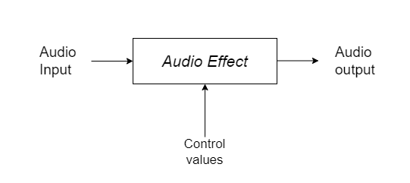
Real-time Audio Effects
Challenges
Enhanced sound
Eliminating unwanted audio artifacts
Low latency
Computational complexity
Sound quality
Real-time parameter adjustment
Notes:
Arthur
As the title suggest our main goal was to implement customizable real-time audio effects on the FPGA. Essentially an audio effect can have two purposes. One is to enhance the sound, to enrich the sound by emphasizing or adding certain elements of the audio signal. Another goal for an audio effect can be is to remove unwanted audio artifacts as we will see later in this presentation.
On the right we can capture the essence of an audio effect, of which a signal is put in the audio effect together with certain control values to change how the audio effect is behaving and thus modifying the audio output in a certain manner.
With implementing customizable audio algorithms, a few key challenges arise. Low latency is important because we do not want the user to have a noticeable delay between the input and the output of our proposed design. The computational complexity of algorithms can be correlated with the latency experienced, as there are certain resource limitations to the FPGA. As the number of calculations increases, it requires a larger number of clock cycles on the FPGA and thus computational complexity can introduce latency. Another key challenge is to achieve a high sound quality, which leads to a better user experience. Furthermore parameter adjustments are important more specifically that they can be manipulated in real-time.

Slide 5
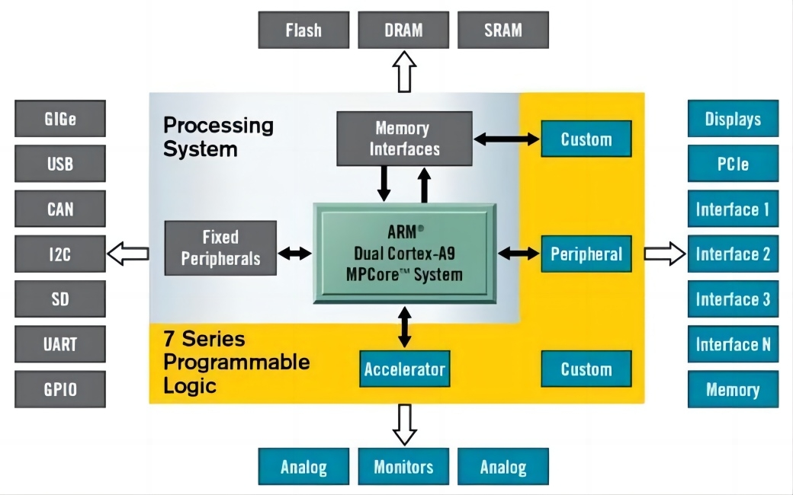
How was this achieved?
FPGA
Prototyping hardware circuits
Reconfigurability
Fast processing
PS-PL co-design
Processing System: control values
Programmable Logic: algorithms
Real-time data communication
Notes:
Arthur This implementation made use of the FPGA, the FPGA essentially is converting software code into digital circuits using a hardware description language like (in our instance) VHDL. This platform is preferred because it has high reconfigurability, meaning that it can be programmed and re-programmed, which enables us to test and prototype our algorithms. Furthermore, the FPGA has fast processing which leads to lower latencies.
The pynq board we used has both a processing system (PS) and programmable logic. PS is a traditional processor which is used in our implementation to run a python notebook in which we can control the parameter values in a user-friendly manner (GUI). These parameters are then sent in real-time to the PL which contains our algorithms. In this way real-time data communication is taking place between the PS and PL.

Slide 6
2. Implementation of Audio Data Pipeline
Notes:
Arthur

Slide 7
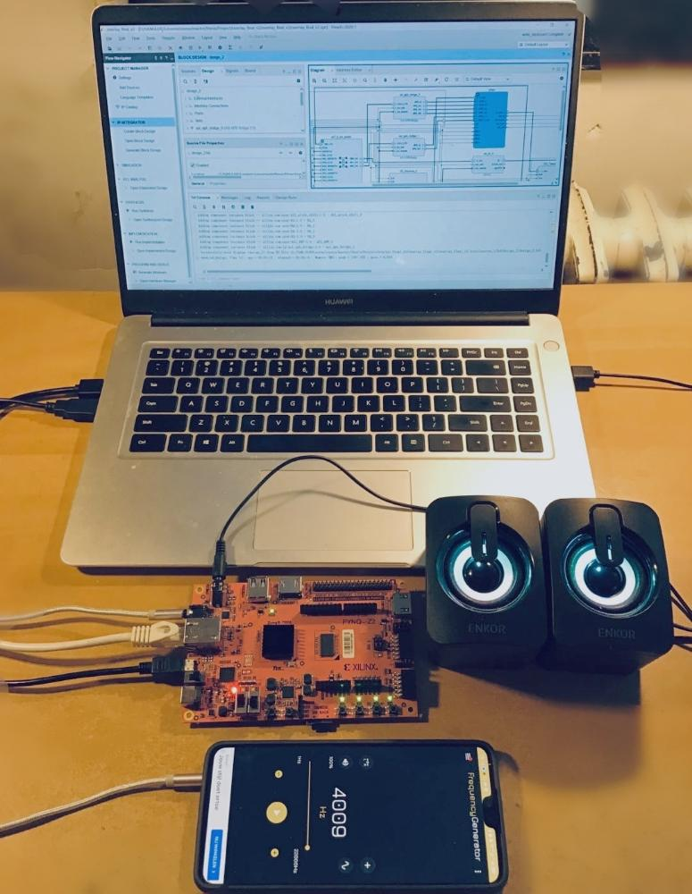
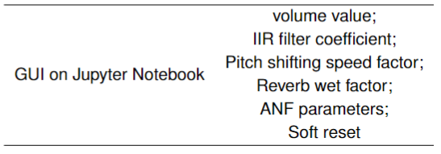
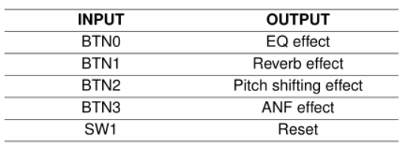
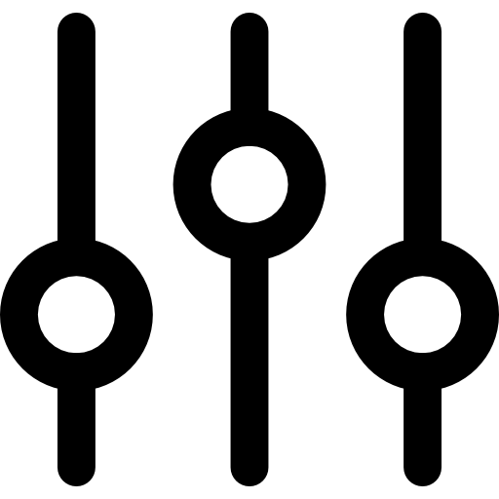
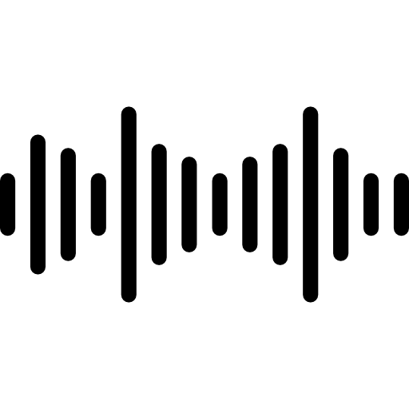
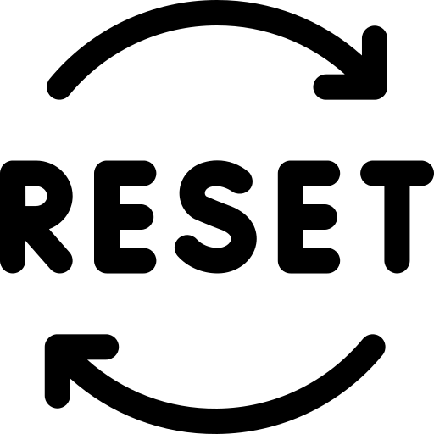


Implementation Overview
On-the-fly control
GUI
Audio Out
Reset/Power
Audio In
Button ctrl/
LEDs indicator
Notes:
Yan/ We have designed a stereo audio processing pipeline. This system can capture real-time audio signal and sent it to the algorithm modules pre-designed on the FPGA. The processed signal is played back through a loud speaker or headphone.We have designed GUIs for the individual algorithms so that the user can change the parameters of the algorithms on the fly. Buttons and LEDs on the board are used to enable the algorithm modules.

Slide 8
Block Diagram
FPGA
Equalizer
Reverb
Pitch Shift
ANF
AUX In
ADC
DAC
HP Out
Audio Effects
Control Values
PS
Notes:
Yan/ The audio signal first goes to the ADC on the FPGA, which converts the analogue signal into a digital signal. We then built four algorithm modules to enhance the signal. The four modules are connected in serial, which allows multiple algorithms to be switched on at the same time. Each algorithm module is switched on by a separate button control. Finally, the processed digital signal is converted back to analogue, and goes to the output. the PS is used to send the control parameters in real time.

Slide 9
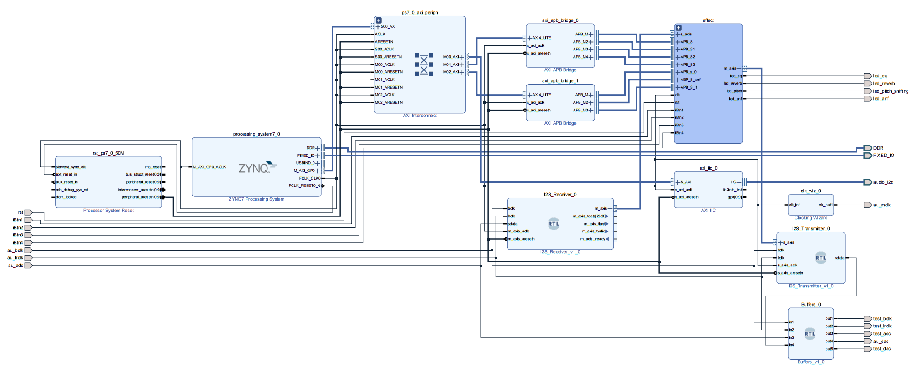
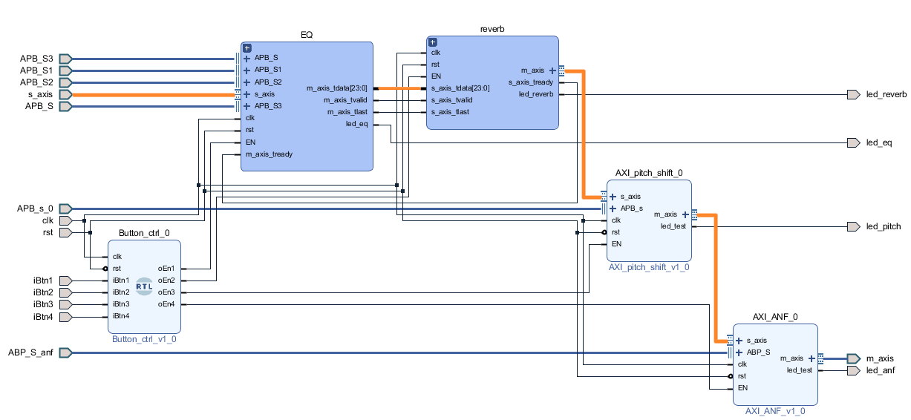
Overlay Design
Switch
AXI/APB Bridge
Audio Effects
Equalizer
Reverberation
Processing system (PS)
Reset
Pitch Shifting
I2S Receiver
Button/LEDs ctrl
I2S Transmitter
ANF
Notes:
Yan/ The first step is to design our overlay. The overlay is an important concept in software and hardware co-design methodology. The Overlay is a pre-designed and pre-verified hardware design that works with the Processing Sysytem of the PYNQ structure. It allows the user to extend software application to the hardware circuit.
As you can see in the picture, the blocks in red color are IP core from xilinx company. The blocks in yellow color are custom IP cores we built by ourselves. this is the processing system IP core, It works with the Switch block, reset block and the APB bridge block to implement the data communication between PS and PL.
I2S receriver is used to read digital data from the ADC. I2S transmitter is used to write data to the DAC.
the audio effect block is where we implement the algorithms.
this is the inside look of the Effects module. you can see the four algorithms are connected in serial and controled by the button/leds control module.

Slide 10
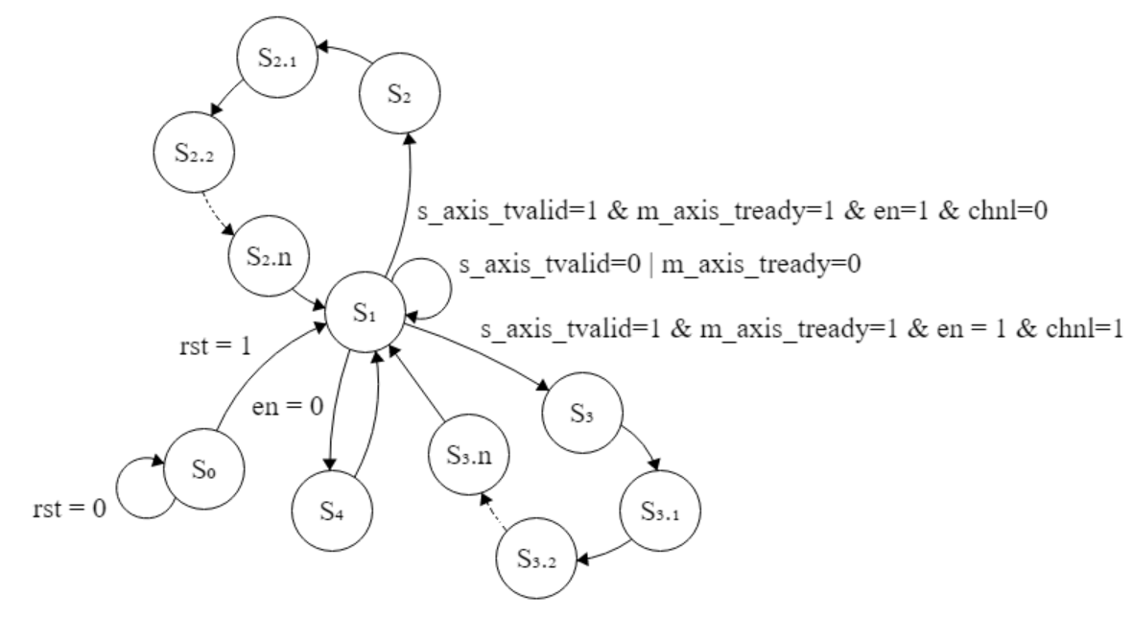
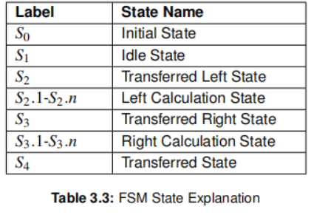
Audio Effect FSM
Notes:
Yan / The second step is to build an FSM for each algorithm module to ensure that data can flow smoothly through the pipeline.
the FSM starts with an initial state and initialises all variables.
S1 is the idle state, in which the module waits for a new input data frame and determines whether the data frame belongs to the left or right channel.
This is the left calculation state and this is the right calculation state. Algorithms are implemented here and sent to the output port. The number of calculation states depends on the complexity of the algorithm.
If the algorithm module is switched off, it will go directly to the transferred state S4 where the data is not processed and sent directly to the output port

Slide 11
3. Implementation of algorithms

Slide 12
Audio effects categorization
Adaptive based
Modulation based
Chorus
Flanger
Tremolo
Adaptive Notch Filtering (LMS)
Single Channel Noise Reduction (Kalman)
Spatial based
Frequency based
Interaural time difference (ITD)
Interaural level difference (ILD)
Low pass filter, High pass filter, BP
Peaking filter
Graphic EQ
Pitch based
Auto-tune
Pitch Shift
Dynamic based
Time based
Compression
Limiter
Reverberation, Delay, Echo
Notes:
Arthur
These Audio effects where some of the ones we considered. In this presentation we will go further into detail on the Adaptive Notch Filter which is an adaptive based algorithm and the Reverberation algorithm which is time based. It should be noted that the graphic equalizer and pitch shift algorithms were implemented as well, further details of these implemented algorithms are discussed in the master thesis.

Slide 13
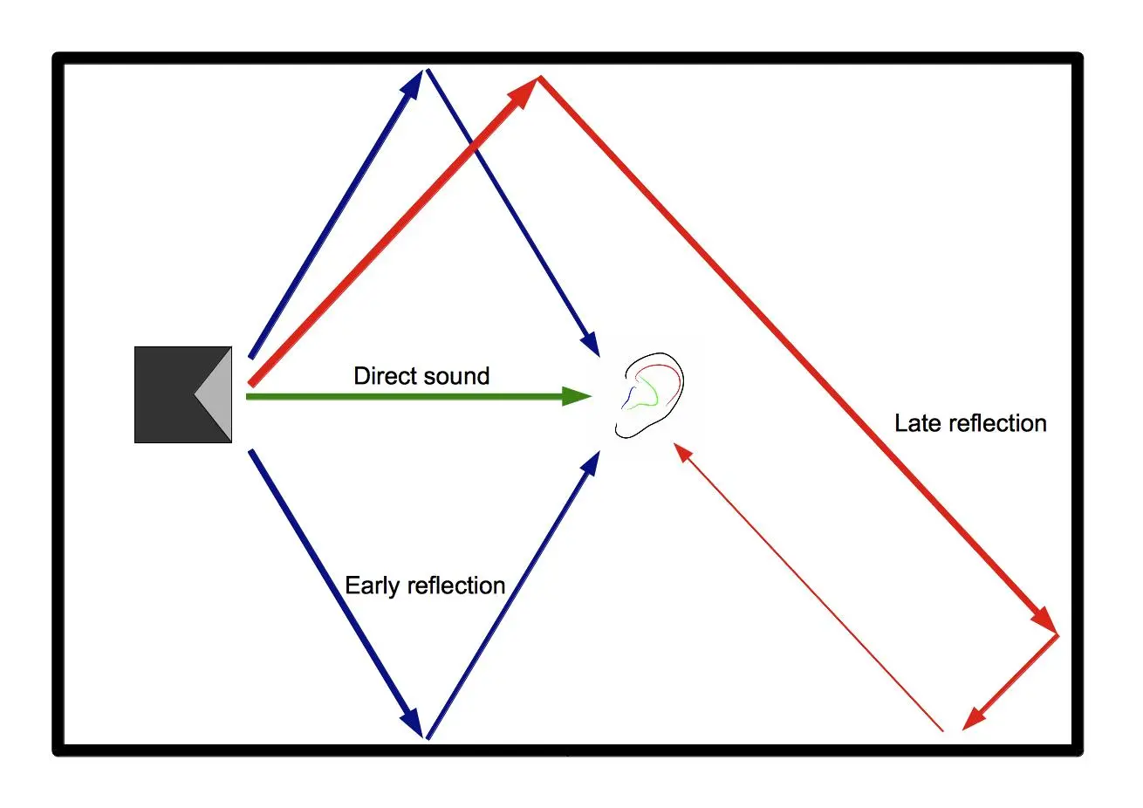
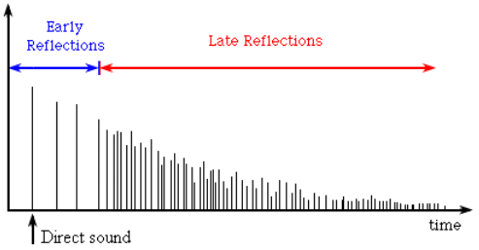
Time based: Reverberation
Figure (left) source: Al-Karawi, K. A., & Mohammed, D. Y. (2019). Early reflection detection using autocorrelation to improve robustness of speaker verification in reverberant conditions. Figure (right) source: https://vocal.com/dereverberation/early-reflections/
Notes:
Arthur
When a sound source is placed into an acoustic room the sound waves can reach the human ear in three ways. The first one is the direct sound, the sound waves travel directly to the listener or microphone. The second are early reflections, typically they characterized by only reflecting from the walls only once. These cause delayed and scaled copies of the direct sound which can be observed in the figure on the right. Lastly, we have the late reflections, which are the most challenging to implement in reverberation algorithms and are the main challenge of this algorithm, since as time increases the impulse response its impulse density increases, which can be seen in this figure on the right.

Slide 14
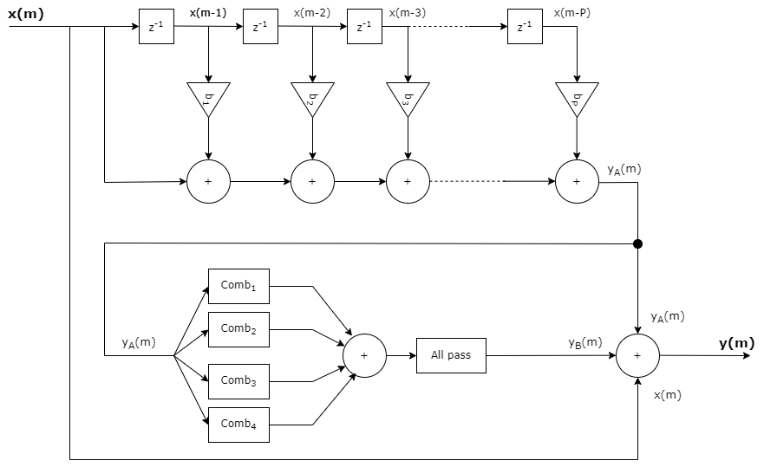
Reverberation: Moorer-Schroeder
Early Reflections
Late Reflections
Direct Sound
Figure (right): https://vocal.com/dereverberation/early-reflections/
Notes:
Arthur
The algorithm we implemented is based on the Moorer-Schroeder approach, which also consists of the same three elements. To simulate the early reflections, a tap delay line was used. It is built using delay elements [z^-1], which in hardware we expect to be flip-flops. And then multiplied with their corresponding FIR filter coefficients. The late reflections with a combination of parallel feedback comb filters and an all-pass filter.

Slide 15
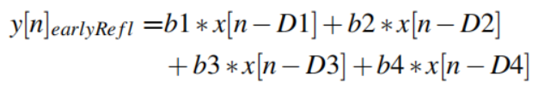
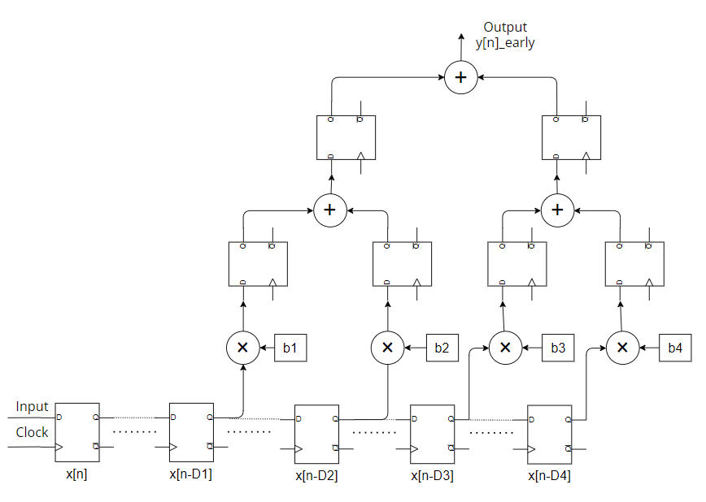

Early reflections implementation
Equation:
Intermediate variables
Figure (right down): https://vocal.com/dereverberation/early-reflections/
Notes:
Yan / This is the hardware implementation of early reflection. The idea is to weight and sum the delayed data.
We use shift registers to build the delay signal. The input data frame is stored into the first shift register and shifted backwards on each clock cycle.
We use multiplier unit to multiply the delay signal by the factor b.
The adder unit is used for summing.
These intermediate registers are used to store intermediate variables. And to keep all calculations synchronised.

Slide 16
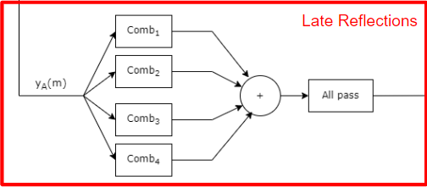
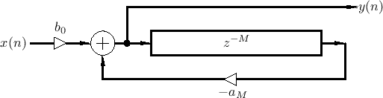
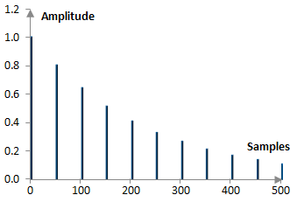
Late reflections
Feedback Comb Filter
Figure (upper left) source: https://ccrma.stanford.edu/~jos/pasp/Feedback_Comb_Filters.html
Figure (down right) source: https://www.recordingblogs.com/wiki/comb-filter
Figure (right down): https://vocal.com/dereverberation/early-reflections/
Notes:
Arthur
this is the block diagram of the feedback comb filter. As you can see the comb filter is recursive which means that each output of the delay line is scaled and fed back into the input and delayed further, this will create a series of exponentially decaying echos in the impulse response. An important remark is that the magnitude of aM should be smaller than one otherwise the system becomes unstable.
The feedback comb filters are implemented in parallel, and thus delay time of the different feedback comb filters should not be the same and should be prime numbers, this will ensure that the impulse responses will not overlap. And thus a higher pulse density is achieved and peaks in the impulse response are avoided.
This is the corresponding equation to calculate the output.

Slide 17
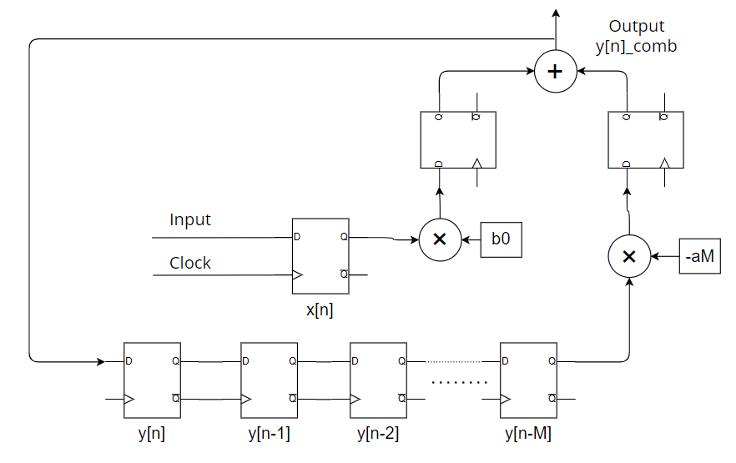
Late reflections implementation
Comb filter Equation
Intermediate variables
Figure (right down): https://vocal.com/dereverberation/early-reflections/
Notes:
Yan
The hardware implementation of the comb filter is very straightforward.
Shift registers are used to create the delay signal.
The delayed signal goes into the multiplier. It is scaled and fed back to the input and further delayed.
The output stage uses two intermediate registers to synchronise the calculations.
Here, four parallel comb filters were created to simulate the reflections of the room. Different delay factors M produce different reflections effects. m should be a prime number to ensure that the frequency responses do not overlap.

Slide 18
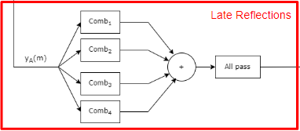
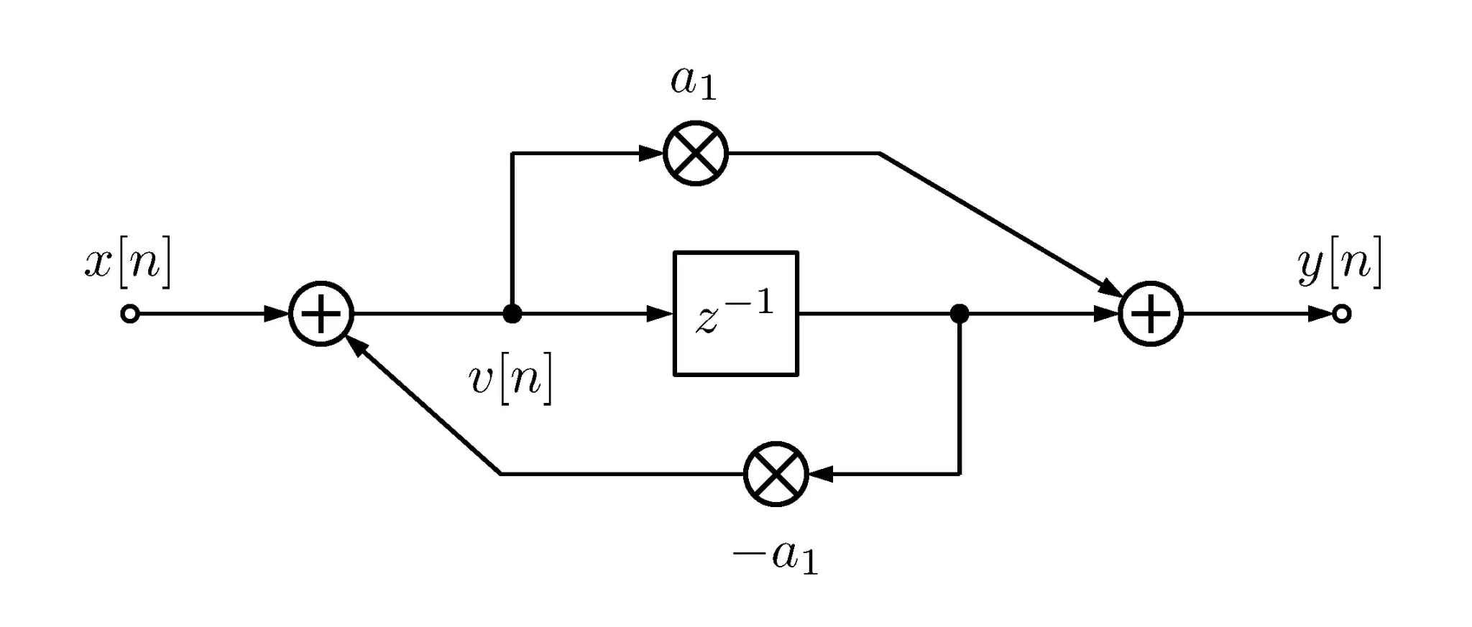
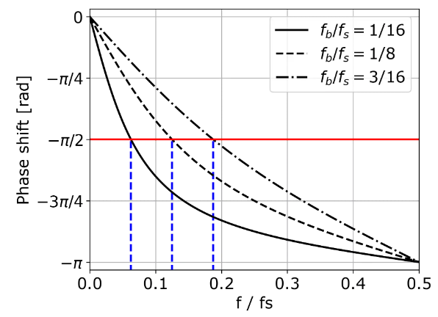

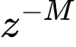
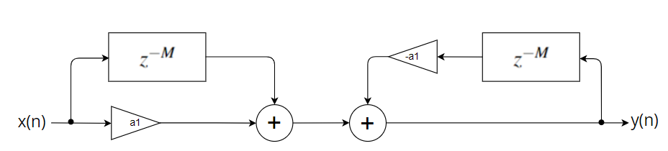
Late reflections
1st order All pass filter
equivalent
Figure (upper left) source: https://thewolfsound.com/allpass-filter/
Figure (right down): https://vocal.com/dereverberation/early-reflections/
Notes:
Arthur
To further increase the pulse density of the impulse response an all-pass filter is used to smear out the signal. For the all-pass filter the magnitude response is 0 dB for every frequency. The phase response can be observed here, where the phase shift is zero at DC and decreases over the frequency spectrum to -PI, by this phase shift which is equivalent to delay is achieved over a large range of frequencies. The break frequency indicated by fb is controlled by the a1 parameter in the block diagram. Furthermore, the block diagram is converted into the following structure in order to implement it on the FPGA.

Slide 19
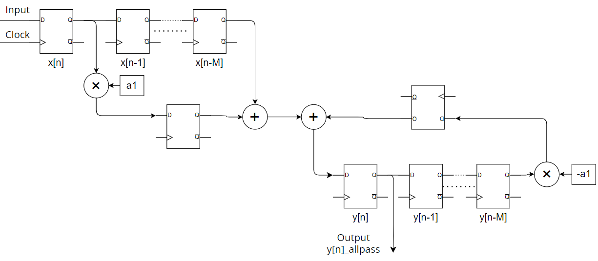
Late reflections implementation
Allpass filter Equation
Figure (right down): https://vocal.com/dereverberation/early-reflections/
Notes:
Yan
We build the hardware circuit based on the equivalent block diagram of an all-pass filter.
It can be seen that the all-pass filter is made up of a feedback comb filter and a feed-forward comb filter.
We need to create delay lines for input x and output y respectively.

Slide 20
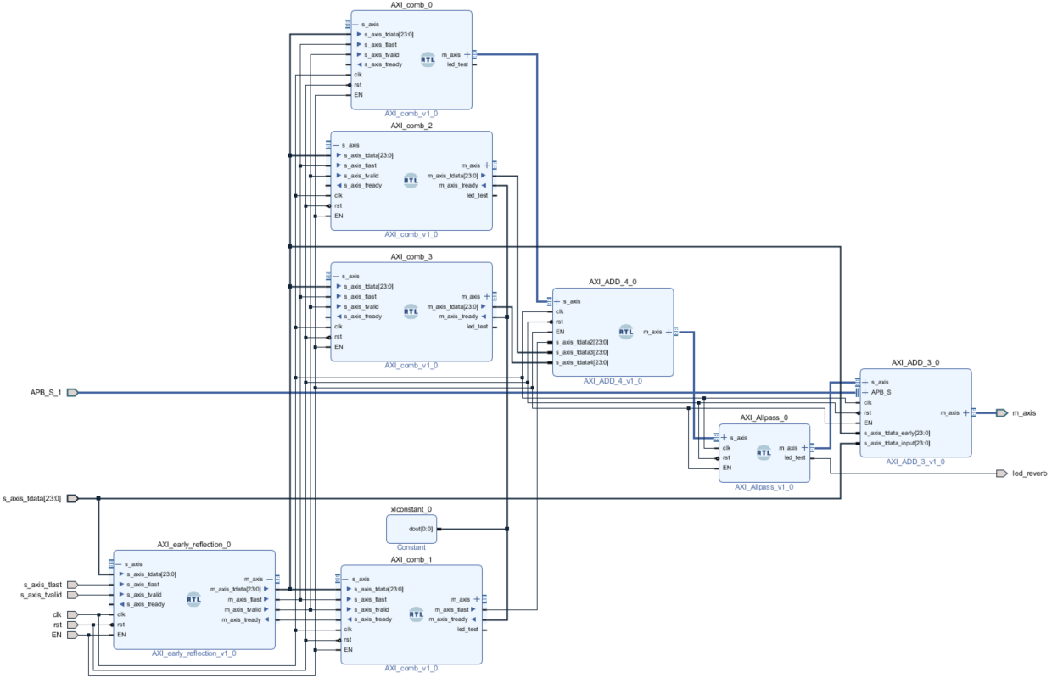
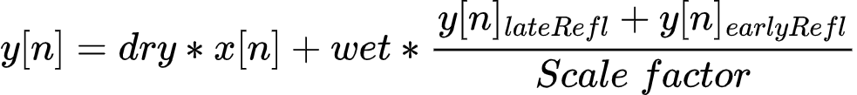
Reverberation (Reverb) Implementation
Comb 1
Comb 2
PS
Comb 3
+
Wet/Dry factor
+
data frame out
All Pass
data frame in
Early Reflection
Comb 4
Notes:
Yan
…
the wet factor refers to the proportion of the processed sound compared to the original sound(or dry sound).
the equation is like this
The user can change the wet and dry factor on the PS side

Slide 21
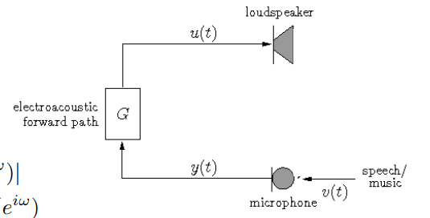
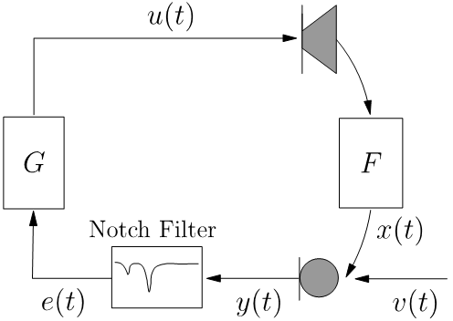

Adaptive based: Adaptive Notch Filter
Acoustic Echo Problem
Adaptive Notch Filter (ANF)
Automatic detection, estimation, and removal of howling
T. van Waterschoot, “Adaptive notch filters for acoustic feedback control,” Course text Digital Signal Processing-2, KU Leuven, Oct. 2014.
Notes:
Arthur
On the left we see a setup with one speaker and one microphone, in a closed loop system where the gain is greater than one. Once an audio signal is picked up by the microphone, the signal will be amplified (G > 1) and then put out by the loudspeaker. Furthermore, the microphone will pick the audio signal back up, which is then amplified again and put out by the loudspeaker… You can quickly see that it is an unstable system.
This phenomenon is called “howling”, and thus it can lead to a very disruptive user experience, and has the risk of damaging equipment. The adaptive notch filters (where I will refer to as ANF) is one solution (of many) to this acoustic echo problem. They are designed to estimate and attenuate the frequency at which the howling occurs while having minimal effect on nearby frequencies, this is to prevent any changes to the original sound. The ANF is changing it’s parameters over time, and thus the specific howling frequency does not need to be known beforehand.

Slide 22
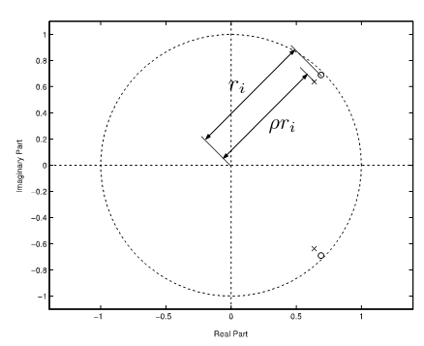
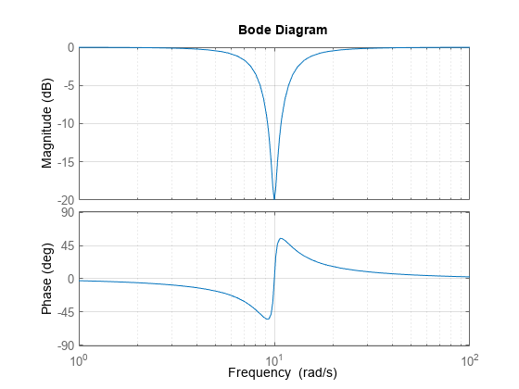
Notch filter
Constraints
• The poles and zeros of H(z) lie on the same radial line in the z-plane, with a pole radius between 0 and 1.
• The zeros of H(z) are located on the unit circle in the z-plane.
Source (Figure): https://nl.mathworks.com/help/control/ug/discretizing-a-notch-filter.html
Source: T. van Waterschoot, “Adaptive notch filters for acoustic feedback control,” Course text Digital Signal Processing-2, KU Leuven, Oct. 2014.
Notes:
Arthur To eliminate this disruptive sound, a notch filter is used, which can be recognized by its magnitude response. In the context of our algorithms two constraints were introduced to ensure the proper behaviour of the ANF. The first constraint is that the poles and the zeros are located on the same radial line with a pole radius smaller than 1, which will ensure that the filter will behave as a notch filter. The pole radius should be smaller than one to ensure stability.

Slide 23
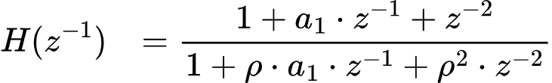
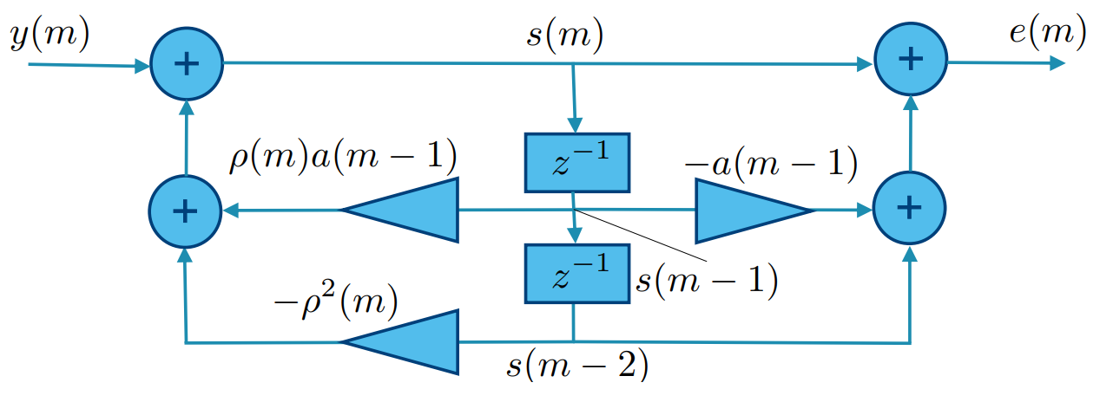
Constrained Notch Filter
IIR Direct form II structure
Source: T. van Waterschoot, “Adaptive notch filters for acoustic feedback control,” Course text Digital Signal Processing-2, KU Leuven, Oct. 2014.
Notes:
Arthur
Furthermore, the zeros should be located on the unit circle in the z-domain. By doing this we get a simplified transfer function which looks like this … Where a_1 equals the main filter coefficient that determines the frequency position, while rho is the pole radius -> which will determine how close the poles and zeros will be located to each other.
Here the direct form II structure can be observed of the ANF-LMS algorithm, it only involves two delay elements that delays the variable s(m) which is the ANF state vector which is an intermediary results which contains the input signal, the pole radius and frequency position of the filter.

Slide 24
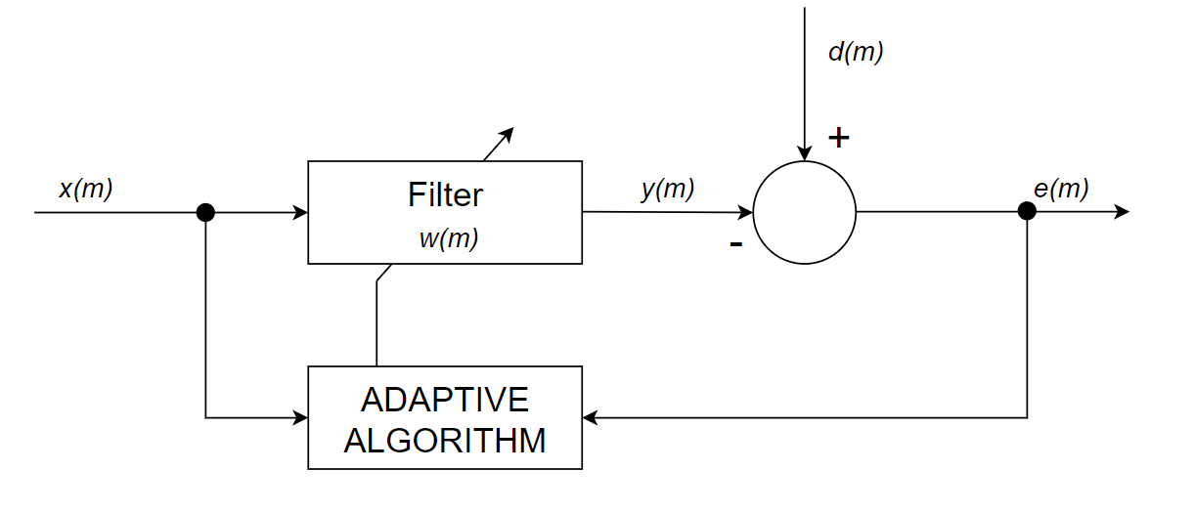
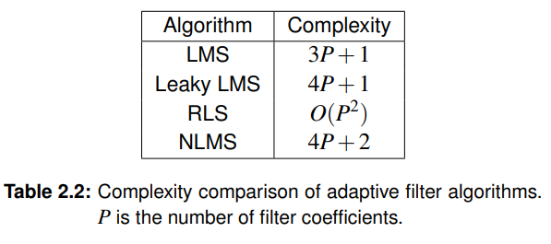
Adaptive algorithm
General adaptive scheme
Adaptive algorithms
General adaptive algorithm
Notes:
Arthur
On the left a general adaptive scheme of a filter can be seen. The general goal of an adaptive system is to obtain the desired signal, denoted as d(m). An estimated signal y(m) is produced by filtering the input signal x(m). This difference between the desired signal and the estimated signal is the error signal which is used to adjust the filter coefficients w(m) to minimize the error. Which can also be seen in the general adaptive algorithm equation. One key thing to understand is that for different adaptation algorithms they use different methods to calculate the adaptation gain. In the following table we can see some of the different algorithms where P is the amount of filter coefficients in the filter. The LMS algorithms has the lowest complexity and thus is used in a great deal of applications.

Slide 25
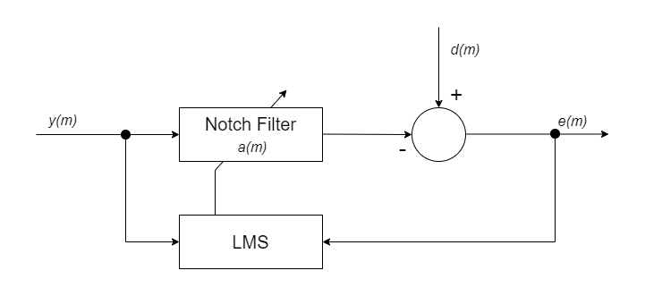
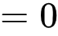
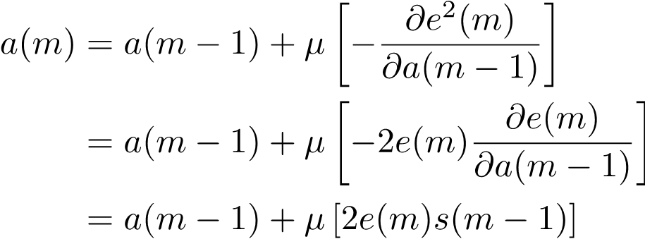

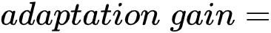
LMS Algorithm
ANF-LMS adaptive scheme
General adaptive algorithm
LMS coefficient update
ANF - LMS filter coefficient update
Notes:
Arthur
So the LMS algorithm functions the same as the general adaptive algorithm, but in the LMS algorithms the coefficient is updated in the following manner. This takes the negative partial derivation of the error squared with respect to the filter coefficients of the previous time instance. If we compute this for the notch filter we get the following ANF-LMS coefficient update. Where mu * 2 * s(m-1) is the adaptation gain and the error signal is still e(m).

Slide 26
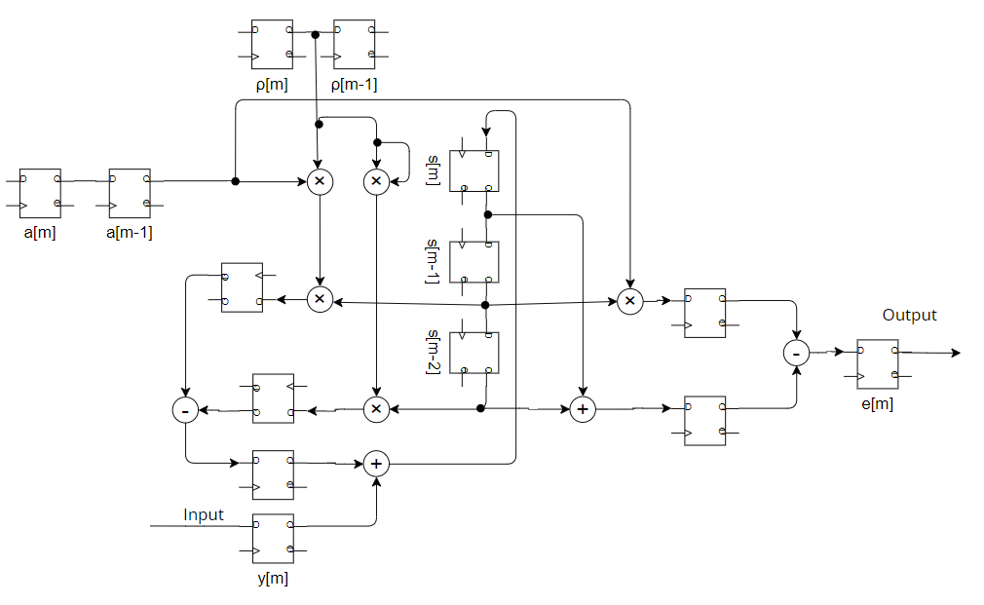
Adaptive Notch Filter (ANF) Implementation
Constrained Notch filter
Notes:
Yan
First we need to create a Constrained notch filters based on the IIR direct 2 structure.
We used shift registers to create delay lines for the polar radius variable rho, the delay variable s and the filter coefficients a
they are to store the current and past values of the variables respectively.
We used multipliers, adders and subtractors to calculate the Intermediate variables. they are then stored into intermediate registers.
It is used to synchronise the calculations to prevent any timing problems.
Now we have a constrained notch filter with constant gain and frequency band. We need then to apply the LMS algorithm to minimize the error and update the coefficient a

Slide 27
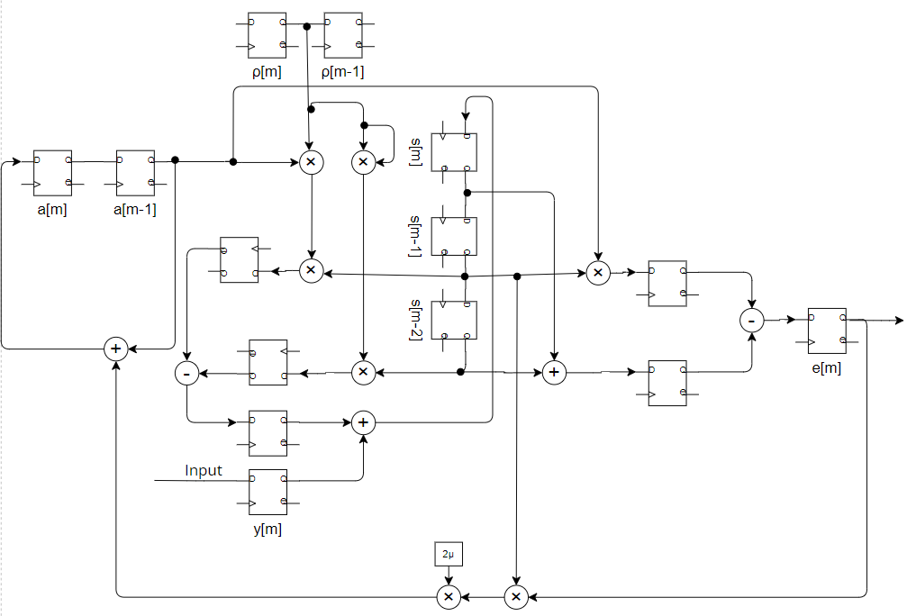
Adaptive Notch Filter (ANF) Implementation
ANF - LMS filter coefficient update
IIR Direct form II structure
LMS
Notes:
Yan
This is the hardware implementation of the adaptive noth filter.
this circuit use LMS algorithm to minimize the error and update the filter coefficient. The equation is shown here. We used two multipliers to calculate the adaptation gain e*s*2u and added it to the previous a. The result is finally assigned to the flipflop that stores a[m]
The user can change the step factor u on PS side, This factor determines the speed of convergence of the ANF

Slide 28
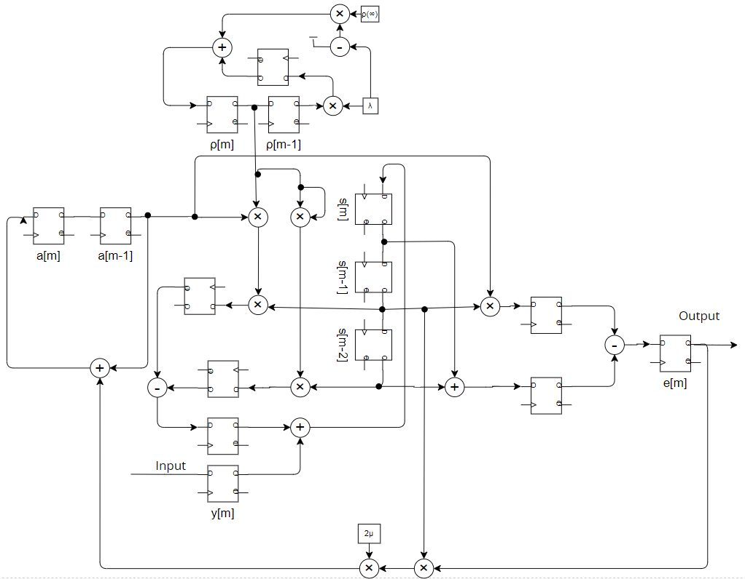
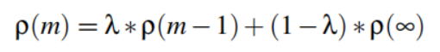
Adaptive Notch Filter (ANF) Implementation
Update ρ
ρ(m)
ρ(∞)
small λ
Gain
Gain
big λ
ρ(0)
f
f
t
Notes:
Yan
The pole radius rho determines the attenuation of the frequency band. More rho will lead to more attenuation. Since the Notch filter starts from a random value, so we want the rho start from a small number to ensure the initial frequency band is not attenuated. and smoothly transitions to a the big number in the speed of lambda.
This is the equation to achieve this.

Slide 29
4. Result and Discussion

Slide 30
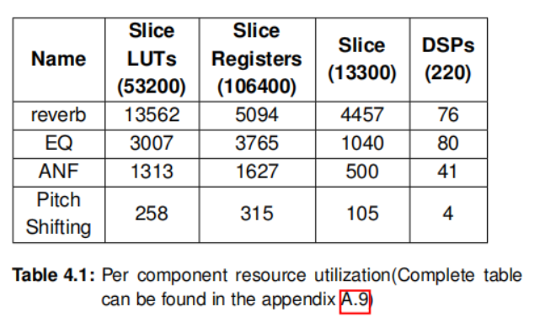
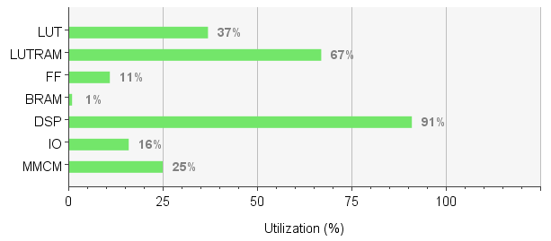
Physical Utilization
Heavily relies on DSP resources(91%) => High demand for signal processing operations
Optimisation: optimise algorithms, reuse DSP resources, use other resources instead,
combine left and right channels => can save half the resources
Notes:
Yan

Slide 31
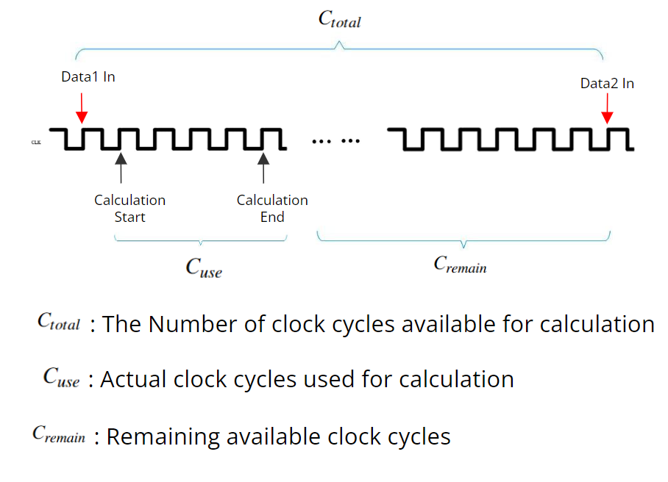
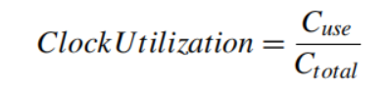
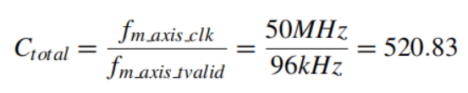

Clock Utilization
Definition
Notes:
Yan
Clock utilization refers to the ratio of the clock cycles being used for the calculation to the available clock cycles.

Slide 32

Clock Utilization
High remaining clock utilization
=> Support for more complex algorithms
The module with the highest clock utilisation: ANF
Why? => Most computational steps, most complex algorithms
Notes:
Yan

Slide 33

Delay Analysis
Reverb contributes most to input-output delay
Why? => The largest number of modules connected in series
=> Integration of multiple modules in one module will reduce the delay
Total Delay: 229.13us => Too small to be noticed
Notes:
Yan

Slide 34

Audio Effects Performance – Reverb
Input: square wave with a duty cycle of 1% and a low frequency: 10 Hz,
Notes:
Arthur
Here a oscilloscope measurement can be seen of the input in yellow and the output if blue of our Reverberation algorithm. We tried recreating an dirac function by using a very small duty cycle, low frequency square wave. This looks similar to the impuls response we have seen before.

Slide 35


Audio Effects Performance – ANF
Test1 input:
Notes:
Arthur
To test the ANF, we generated a series of sinusoids at different frequencies. The input spectrogram can be seen in the spectrogram on the top. While the output of the algorithm can be seen here. The Adaptive Notch Filter seems to be working as it is attenuating the different narrrowband frequencies while still adapting to them leaving room for these high peaks to occur. The adaptation stepsize in this case was fairly large.

Slide 36
Conclusion

Slide 37
Conclusion
Designed and implemented real-time stereo audio processing pipeline on the FPGA framework
Control on the fly
Can be extended easily
Low latency - microsecond level
Support for complex audio algorithms => 95%+ Remaining Clock Utilization
High Sound Quality - High sampling rate
Implemented four audio algorithms with good performance
Utilize the logic cells, memory blocks, DSP, and other resources in the FPGA to build hardware circuit for audio algorithms
4-band Equalizer: adjustable gain, frequency and Q factor
Reverberation: adjustable wet and dry factor
Pitch Shifting: modify pitch without changing playback speed;
Adaptive Notch Filter: acoustic echo removal using an adaptive notch filter and the Least-Mean-Squared algorithm

Slide 38
Demo

Slide 39
DEMO
On-the-fly control
GUI
Audio Out
Reset/Power
Audio In
Button ctrl/
LEDs indicator
Notes:
Yan

Slide 40
Questions & Answers

Slide 41


Slide 42


Slide 43


Slide 44





4 Band Equalizer (EQ) Implementation
Coefficient a0,a1,a2,b0,b1,b2 Calculation:
Input
Output
Corresponding difference equation

Slide 45

Second constraint
Source: T. van Waterschoot, “Adaptive notch filters for acoustic feedback control,” Course text Digital Signal Processing-2, KU Leuven, Oct. 2014.

Slide 46

All pass filter equivalence

